Slide 1
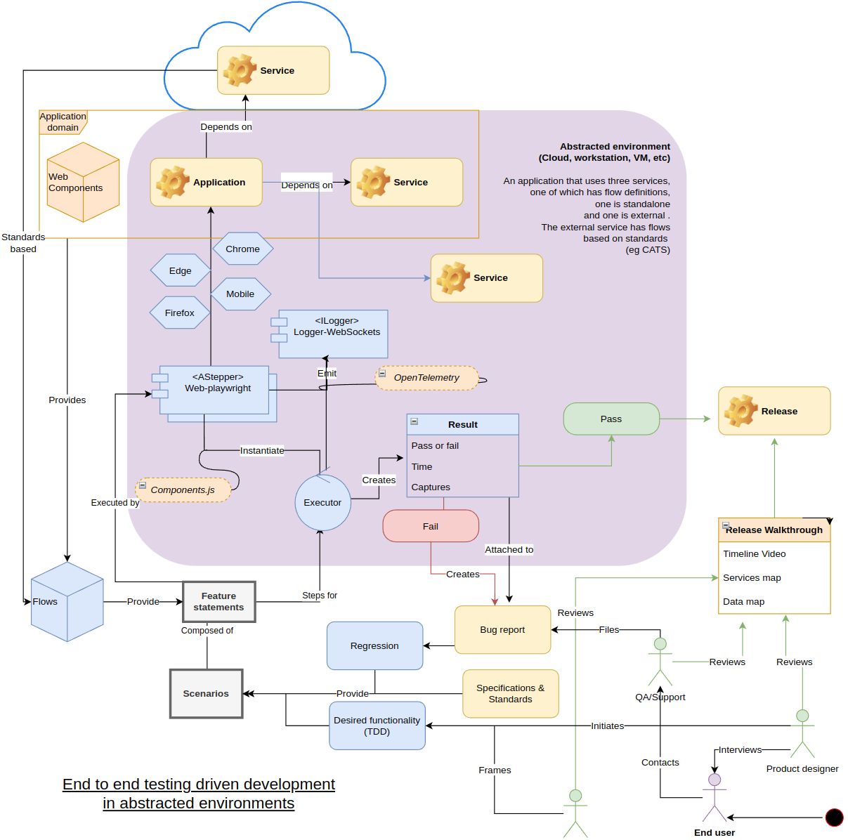
Haibun End to end test driven development in abstracted environments
GC workflow options using Haibun reviews, schemas and graphs Jan 4, 2024
david.mason@tbs-sct.gc.ca
Overview diagram

Slide 2
What was done
Set up Azure Pipelines & Github Actions to run Haibun e2e tests, create review site
Checklist
✓Minimum re-invention
stick to spec, testing, verification, understanding, documentation
✓Good DX
With specs in place, it “just works”
Low level code is separate, just edit natural language
✓Maximum re-use
spec, testing, verification, understanding, documentation
Accessible to varied perspectives
Product manager, developer team, end user
✓Hedge proprietary code
Glue between abstract systems
Creates description of interactions & data
✓Opportunistically provide features
spec, testing, verification, understanding, documentation

Slide 3
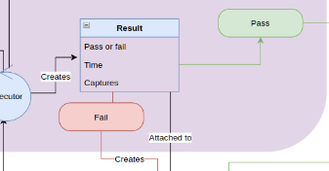
Where does it fit in
On commit to repo, via Github Actions, Azure Devops or both (can also run locally during dev)
In the on-commit pipeline:
Build & start instance
Run tests via Executor
Copy results to a storage location for reviews dashboard
Team members access reviews
(eventually) use as gateways in release pipelines, create tickets, etc

Slide 4
Approach 1: Azure Pipelines
resources:
pipelines:
- pipeline: post-pr-e2e-tests
project: gccollab-IaC-resources
source: gctools-outilsgc.gcconnex - PR
trigger: true
jobs:
- job: e2etests
pool:
vmImage: "ubuntu-latest"
container:
image: mcr.microsoft.com/playwright:v1.40.0-jammy volumes: [e2e-reviews]
steps:
- task: Npm@1
inputs:
command: "ci"
- task: CmdLine@2
displayName: "Run server in background"
inputs:
script: |
npm start &
Sleep 30
- task: CmdLine@2
displayName: "Publish test result history"
continueOnError: true
inputs:
workingDirectory: haibun-e2e-tests
script: |
npm run publish-history-azure
- task: CmdLine@2
displayName: "Publish dashboard"
continueOnError: true
inputs:
workingDirectory: haibun-e2e-tests
script: |
npm run publish-reviewer-azure
- task: PublishTestResults@2
inputs:
searchFolder: "$(System.DefaultWorkingDirectory)/haibun-e2e-tests"
testResultsFormat: "JUnit"
testResultsFiles: "junit/**.xml"
# - checkout: e2etest
- task: Npm@1
displayName: "installing dependencies"
inputs:
workingDir: haibun-e2e-tests
command: "ci"
- task: CmdLine@2
displayName: "make junit test directory"
continueOnError: false
inputs:
workingDirectory: haibun-e2e-tests
script: |
mkdir junit
- task: CmdLine@2
displayName: "Running home e2e tests"
continueOnError: true
inputs:
workingDirectory: haibun-e2e-tests
script: |
HAIBUN_O_WEBPLAYWRIGHT_HEADLESS=true npm run test home
Triggers on commit, runs tests, produces reviews site hosted in azdo/azure storage

Slide 5
Approach 2: Github Actions
name: "GCCollab Haibun front end tests"
on:
workflow_dispatch:
push:
branches:
- implement-e2e-tests
pull_request:
permissions:
contents: read
pull-requests: read
# This allows a subsequently queued workflow run to interrupt previous runs
concurrency:
group: "${{ github.workflow }} @ ${{ github.event.pull_request.head.label || github.head_ref || github.ref }}"
cancel-in-progress: true
- name: Run tests
run: |
cd haibun-e2e-tests
npm ci
npm run test home
- name: Checkout Repository
uses: actions/checkout@v2
with:
ref: gh-pages
- name: Publish history
run: npm run publish-history-azure
- name: Publish reviews
run: npm run publish-reviewer-azure
- name: Push Changes
uses: ad-m/github-push-action@main
with:
github_token: ${{ secrets.GITHUB_TOKEN }}
branch: gh-pages
jobs:
e2e_test:
runs-on: ubuntu-latest
container:
image: mcr.microsoft.com/playwright:v1.40.0-jammy
steps:
- uses: actions/checkout@v3
- uses: actions/setup-node@v3.5.1
with:
node-version: 18
- name: Install dependencies
run: npm ci
- name: ng build
run: |
npm start &
sleep 30
- name: wait for it to start (not sure this helps since it fails with a too-short delay)
run: |
npm i -g wait-on
wait-on --log --timeout 30000 http-get://localhost:4200/
Triggers on commit, runs tests, produces reviews site integrated in github pages

Slide 6
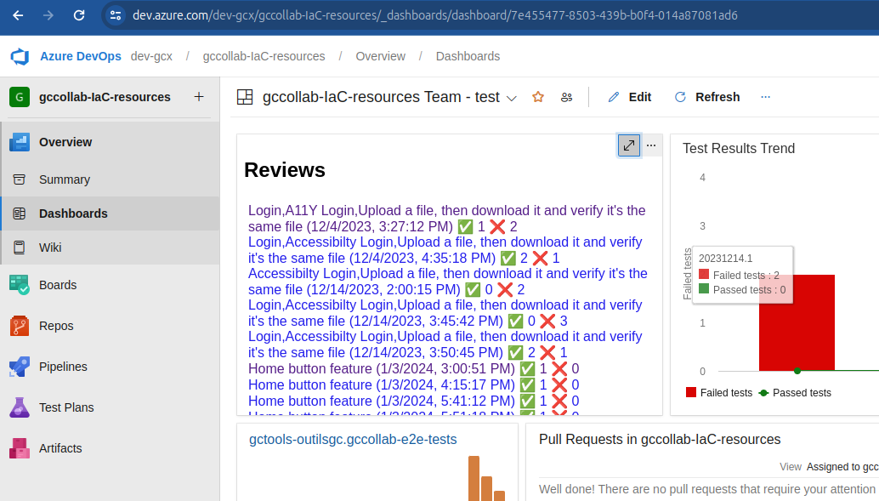

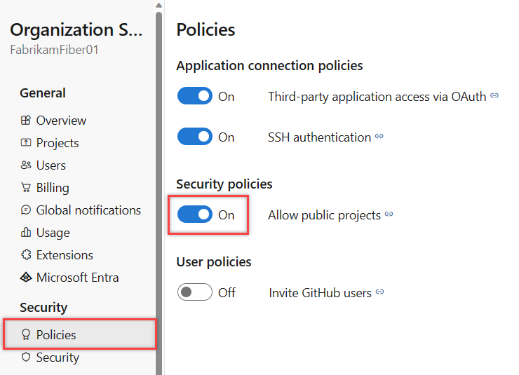
Azure Pipelines evaluation
Build on azdo pipelines, dashboard widgets Advantages
Azure Storage can manage assets, including expiration
All project reviews stored in one place
More opinionated
complete development & deployment pipeline, including gateways
Built in and third party pieces
Disadvantages
Challenging to make it fully public
Less opensourcistical
Split repo & build, difficult to reproduce
More opinionated/friction
Increasing dependency on one vendor instead of choosing interop
https://dev.azure.com/dev-gcx/gccollab-IaC-resources/_dashboards/dashboard/7e455477-8503-439b-b0f4-014a87081ad6

Slide 7
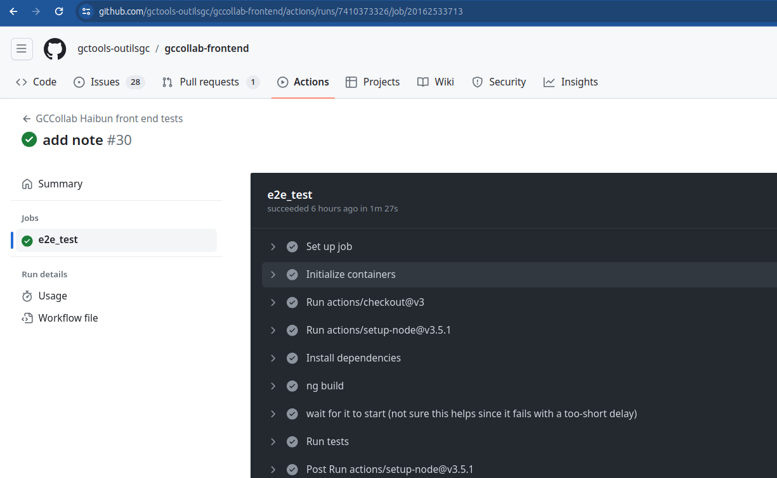
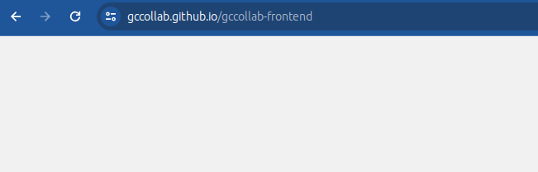


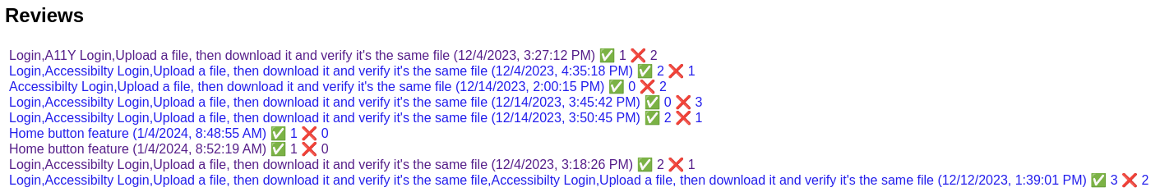
Github pages
Build on Github Actions, Github Pages site
Advantages
More opensourceistical, build in the open
Project is more self-contained on repo
One stop documentation & status
Easy to reproduce - just fork the repo
Less opinionated
Á la carte
Full development pipeline, including gateways
Can be hybrid between github/azdo/others
Disadvantages
Have to manage review results (expiry)
Less opinionated: Find third party apps or create for dashboard, complete process (can always use hybrid)
This is some cool info about the project, links to documentation, etc. Here are recent reviews of builds & deployments

Slide 8
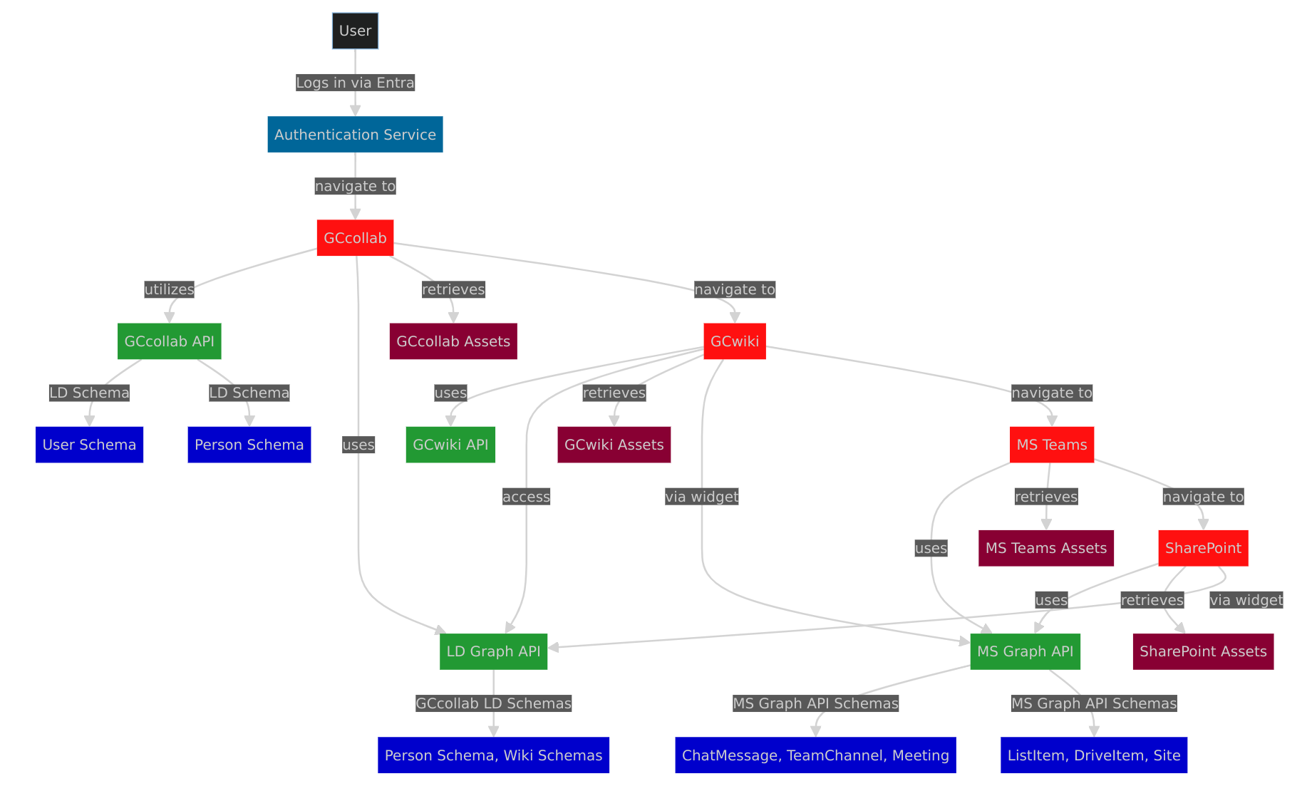
Next steps
Settle on azdo or gh pages
Expand tests for gccollab
E2E smoke tests for gcwikis
GCExchange
Web-vitals extension - https://web.dev/articles/vitals
Automatically generate a map based on output of paths between services; make data more evident

Slide 9
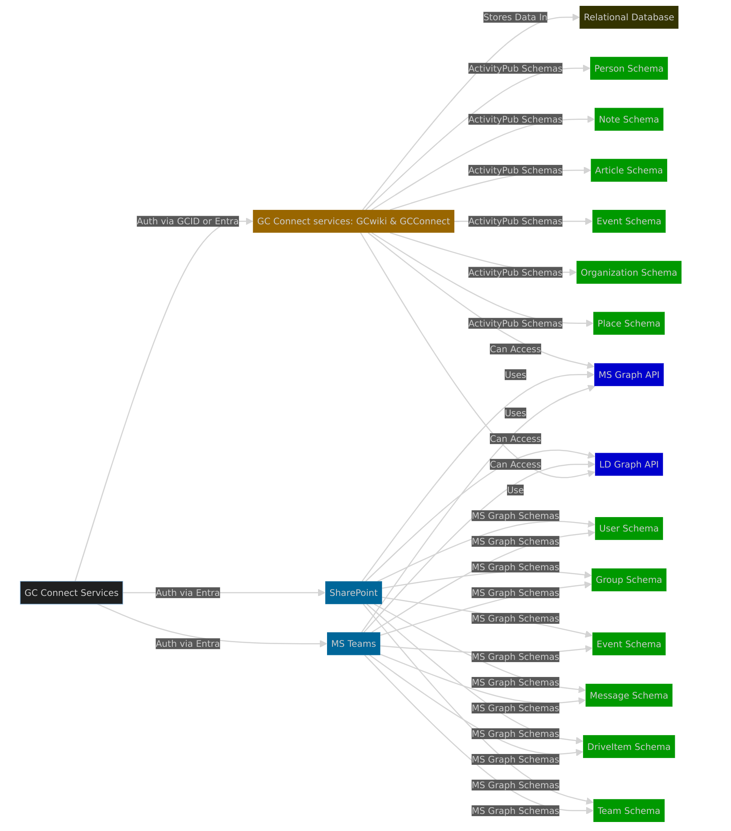
Use of schemas
Standards based (Linked Data), application, vendor (MS, etc)
Provides identity and open-ended relationships for data
Validation
Re-use consistency between services
Grounding for AI systems

Slide 10
Graph features: re-use focus, making relationships clear
Graph Search Algorithms:
Useful for traversing or searching graph data, navigating through nodes by following edges (network based, between services and without having to maintain lookup tables for every type; same-as, subclass-of, etc relationships)
Shortest Path Algorithms: Efficient for finding the shortest path between nodes; networking, recommendation systems
Network Analysis:
Centrality Measures: Identify the most influential nodes in a network, useful in social network analysis, identifying key influencers or hubs
Community Detection: Detect clusters or communities within a network, helping understand group dynamics or segment networks
Recommendation Systems:
Collaborative Filtering: By analyzing the relationships and interactions among users and items, recommend items to a user based on the preferences of similar users
Content-Based Filtering: Recommends items similar to what a user likes, based on their past behavior or preferences graphically represented
Graph-Based Machine Learning:
Graph Neural Networks (GNNs): A type of neural network that directly operates on the graph structure, useful for tasks like node classification, link prediction, and graph classification
Pattern Recognition and Anomaly Detection:
Algorithms can identify patterns, irregularities, or unusual patterns in graphs, which is valuable in fraud detection, network security, and anomaly detection in various domains
Graph Embedding Techniques:
Convert graph data into vector space, enabling the application of traditional machine learning algorithms
Temporal Graph Analysis:
Analyzing graphs that change over time (dynamic graphs) to understand evolving patterns and trends
Add these features to user toolkit instead of backend exclusivity
Requirement/foundation for ontologies, enterprise knowledge graph (KG), reasoning systems

Slide 11
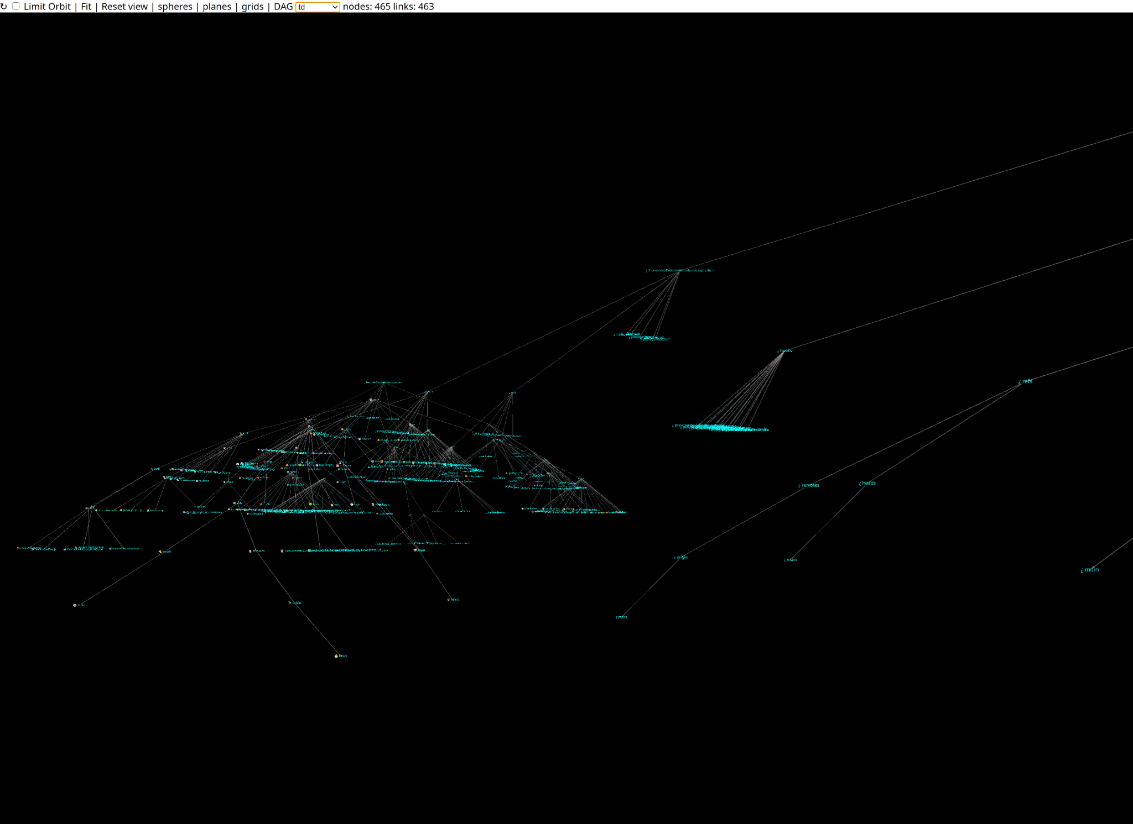
Xmas research
Scalable real time graph
Supports filters, VR
Useful for debugging, whirlygig
https://github.com/withhaibun/graphaibun

